Slide 1
Name : ESHA G
Reg.No. : 211521104042
Naan mudhalvan Id: au211521104042
College Name : Panimalar Institute Of Technology

Slide 2
PROJECT TITLE:
PNEUMONIA DISEASE DETECTION
USING CNN ALGORITHM

Slide 3
AGENDA:
PROBLEM STATEMENT
PROJECT OVERVIEW
WHO ARE THE END USERS?
SOLUTION AND ITS VALUE PROPOSITION
THE WOW IN THE SOLUTION
MODELLING
RESULTS
CONCLUSION

Slide 4
PROBLEM STATEMENT:
Pneumonia detection using Convolutional Neural Networks (CNN) involves developing a model to accurately classify chest X-ray images into normal and pneumonia cases . The primary goal is to achieve high accuracy in identifying pneumonia cases, enabling timely medical intervention for patients.
The objective and automated detection of pneumonia represents a serious challenge in medical imaging, because the signs of the illness are not obvious in CT or X-ray scans. Further on, it is also an important task, since millions of people die of pneumonia every year. The main goal of this paper is to propose a solution for the above mentioned problem, using a novel deep neural network architecture. The proposed novelty consists in the use of dropout in the convolutional part of the network.

Slide 5
PROJECT OVERVIEW:
Pneumonia detection using Convolutional Neural Networks (CNNs) involves training a CNN model with chest X-ray images to automatically identify signs of pneumonia .
CNN models are used as feature extractors followed by different classifiers to classify pneumonia based on chest X-ray images .
The objective is to automate and accurately detect pneumonia from medical imaging, as its signs may not be obvious in CT scans .
CNN models are designed to detect pneumonic lungs from chest X-rays with high accuracy, applicable in real-world medical scenarios .
Transfer learning and enhanced CNN models trained with big data sets are used to identify pneumonia effectively .
Various CNN architectures, such as VGG-based models, are employed with activation functions like sigmoid and ReLU to detect pneumonia from chest X-ray images .

Slide 6
WHO ARE THE END USERS?
The end users in a pneumonia detection project are typically medical personnel, including doctors, radiologists, and healthcare providers . These professionals use deep learning algorithms, convolutional neural networks (CNN), and other machine learning models to assist in diagnosing pneumonia accurately . Additionally, researchers and developers in the healthcare industry focus on creating and improving computer-aided techniques for pneumonia detection . Chest X-rays are commonly used for diagnosing pneumonia, with machine learning models enhancing the detection process . Python programming is often utilized for implementing machine learning and deep learning algorithms in pneumonia detection projects . Organizations and healthcare institutions deploy Kubernetes-based machine learning models to analyze X-ray images and identify patients at high risk of pneumonia .

Slide 7
THE SOLUTION AND ITS VALUE PROPOSITION:
The solution in pneumonia detection projects involves utilizing advanced technologies such as convolutional neural networks (CNNs) and vision transformers to accurately detect pneumonia from medical images, particularly X-ray images . These models aim to achieve high accuracy in identifying pneumonia cases, facilitating prompt treatment and improving patient outcomes . Additionally, machine learning algorithms play a crucial role in assisting medical professionals by providing efficient and accurate solutions for pneumonia detection .
The valuable proposition lies in the ability of these technologies to enhance the diagnostic process, leading to faster and more reliable identification of pneumonia cases, which is essential for effective medical intervention.

Slide 8
THE WOW IN THE SOLUTION:
The "wow" factor in pneumonia detection solutions stems from their ability to revolutionize medical diagnostics and improve patient outcomes significantly. Here are some key aspects contributing to this "wow" factor:
Accuracy
Efficiency
Accessibility
Multi-Disease Detection
Innovation
Overall, the "wow" factor lies in the transformative impact these technologies have on healthcare, leading to faster, more accurate diagnoses, better treatment outcomes, and ultimately, saving lives.

Slide 9
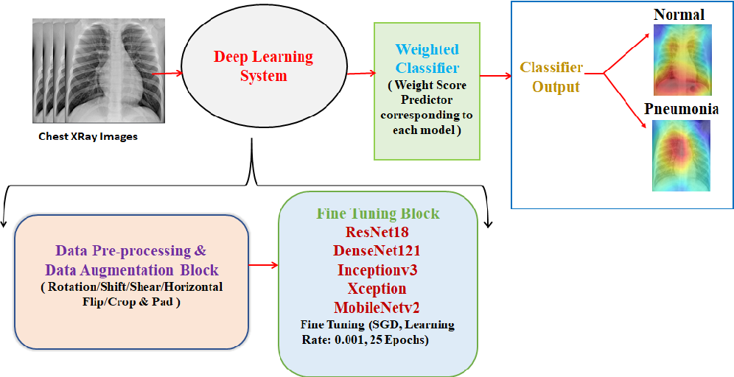
MODELLING:

Slide 10
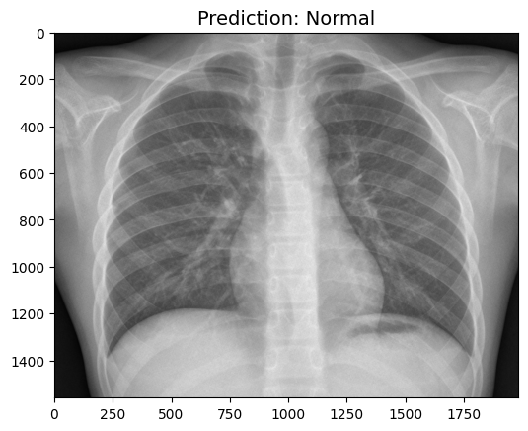
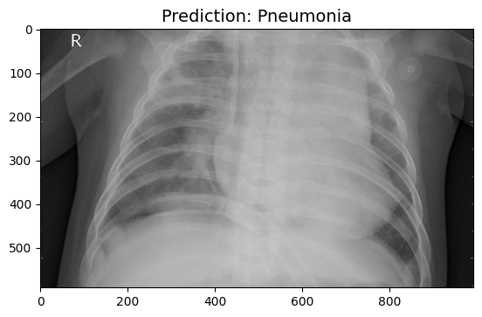
RESULT:

Slide 11
CONCLUSION :
This model can be used in Healthcare industry in the radiological department.
It can be deployed to Xray machines.
This can help radiologist to predict the chest xray images easily and accurately.

